Slide 1

A
Decision-Making Tools
PowerPoint presentation to accompany
Heizer and Render
Operations Management, 10e
Principles of Operations Management, 8e
PowerPoint slides by Jeff Heyl

Slide 2
Outline
The Decision Process in Operations
Fundamentals of Decision Making
Decision Tables

Slide 3
Outline – Continued
Types of Decision-Making Environments
  Decision Making Under Uncertainty
  Decision Making Under Risk
  Decision Making Under Certainty
  Expected Value of Perfect Information (EVPI)

Slide 4
Outline – Continued
Decision Trees
  A More Complex Decision Tree
  Using Decision Trees in Ethical Decision Making
  The Poker Decision Problem

Slide 5
Learning Objectives
When you complete this module you should be able to:
Create a simple decision tree
Build a decision table
Explain when to use each of the three types of decision-making environments
Calculate an expected monetary value (EMV)

Slide 6
Learning Objectives
When you complete this module you should be able to:
Compute the expected value of perfect information (EVPI)
Evaluate the nodes in a decision tree
Create a decision tree with sequential decisions

Slide 7
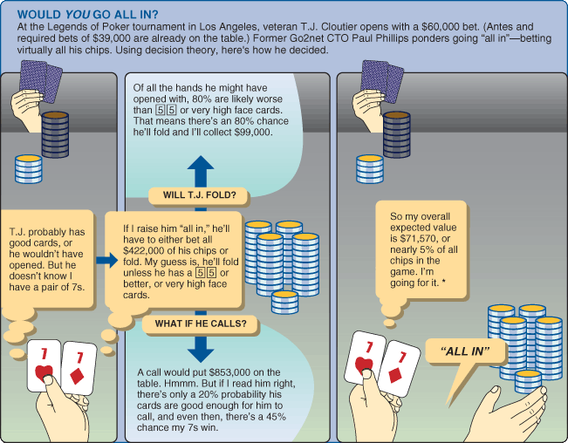
Decision to Go All In

Slide 8
The Decision Process in Operations
Clearly define the problems and the factors that influence it
Develop specific and measurable objectives
Develop a model
Evaluate each alternative solution
Select the best alternative
Implement the decision and set a timetable for completion
Notes:
This slide provides some reasons that capacity is an issue. The following slides guide a discussion of capacity.

Slide 9
Fundamentals of
Decision Making
Terms:
  Alternative – a course of action or strategy that may be chosen by the decision maker
  State of nature – an occurrence or a situation over which the decision maker has little or no control
Notes:
This slide can be used to frame a discussion of capacity.
Points to be made might include:
- capacity definition and measurement is necessary if we are to develop a production schedule
- while a process may have “maximum” capacity, many factors prevent us from achieving that capacity on a continuous basis.
Students should be asked to suggest factors which might prevent one from achieving maximum capacity.

Slide 10
Fundamentals of
Decision Making
Symbols used in a decision tree:
  □ – decision node from which one of several alternatives may be selected
  ○ – a state-of-nature node out of which one state of nature will occur
Notes:
This slide can be used to frame a discussion of capacity.
Points to be made might include:
- capacity definition and measurement is necessary if we are to develop a production schedule
- while a process may have “maximum” capacity, many factors prevent us from achieving that capacity on a continuous basis.
Students should be asked to suggest factors which might prevent one from achieving maximum capacity.

Slide 11
Decision Tree Example
A decision node
A state of nature node
Favorable market
Construct large plant
Unfavorable market
Favorable market
Construct small plant
Unfavorable market
Do nothing
Figure A.1

Slide 12
Decision Table Example
State of Nature
Alternatives Favorable Market Unfavorable Market
Construct large plant $200,000 –$180,000
Construct small plant $100,000 –$ 20,000
Do nothing $ 0 $ 0
Table A.1

Slide 13
Decision-Making Environments
Decision making under uncertainty
  Complete uncertainty as to which state of nature may occur
Decision making under risk
  Several states of nature may occur
  Each has a probability of occurring
Decision making under certainty
  State of nature is known

Slide 14
Uncertainty
Maximax
  Find the alternative that maximizes the maximum outcome for every alternative
  Pick the outcome with the maximum number
  Highest possible gain
  This is viewed as an optimistic approach

Slide 15
Uncertainty
Maximin
  Find the alternative that maximizes the minimum outcome for every alternative
  Pick the outcome with the minimum number
  Least possible loss
  This is viewed as a pessimistic approach

Slide 16
Uncertainty
Equally likely
  Find the alternative with the highest average outcome
  Pick the outcome with the maximum number
  Assumes each state of nature is equally likely to occur

Slide 17
Uncertainty Example
States of Nature
Favorable Unfavorable Maximum Minimum Row
Alternatives Market Market in Row in Row Average
Construct
large plant $200,000 -$180,000 $200,000 -$180,000 $10,000
Construct
small plant $100,000 -$20,000 $100,000 -$20,000 $40,000
Do nothing $0 $0 $0 $0 $0
Maximax
Maximin
Equally likely
Maximax choice is to construct a large plant
Maximin choice is to do nothing
Equally likely choice is to construct a small plant

Slide 18
Risk
Each possible state of nature has an assumed probability
States of nature are mutually exclusive
Probabilities must sum to 1
Determine the expected monetary value (EMV) for each alternative

Slide 19
Expected Monetary Value
EMV (Alternative i) = | (Payoff of 1st state of nature) x (Probability of 1st state of nature)
+ | (Payoff of 2nd state of nature) x (Probability of 2nd state of nature)
+…+ | (Payoff of last state of nature) x (Probability of last state of nature)
Notes:
It might be useful at this point to discuss typical equipment utilization rates for different process strategies if you have not done so before.

Slide 20
EMV Example
Table A.3
States of Nature
Favorable Unfavorable
Alternatives Market Market
Construct large plant (A₁) $200,000 -$180,000
Construct small plant (A₂) $100,000 -$20,000
Do nothing (A₃) $0 $0
Probabilities .50 .50
EMV(A₁) = (.5)($200,000) + (.5)(-$180,000) = $10,000
EMV(A₂) = (.5)($100,000) + (.5)(-$20,000) = $40,000
EMV(A₃) = (.5)($0) + (.5)($0) = $0
Notes:
It might be useful at this point to discuss typical equipment utilization rates for different process strategies if you have not done so before.

Slide 21
EMV Example
Table A.3
States of Nature
Favorable Unfavorable
Alternatives Market Market
Construct large plant (A₁) $200,000 -$180,000
Construct small plant (A₂) $100,000 -$20,000
Do nothing (A₃) $0 $0
Probabilities .50 .50
EMV(A₁) = (.5)($200,000) + (.5)(-$180,000) = $10,000
EMV(A₂) = (.5)($100,000) + (.5)(-$20,000) = $40,000
EMV(A₃) = (.5)($0) + (.5)($0) = $0
Best Option
Notes:
It might be useful at this point to discuss typical equipment utilization rates for different process strategies if you have not done so before.

Slide 22
Certainty
Is the cost of perfect information worth it?
Determine the expected value of perfect information (EVPI)
Notes:
It might be useful at this point to discuss typical equipment utilization rates for different process strategies if you have not done so before.

Slide 23
Expected Value of
Perfect Information
EVPI is the difference between the payoff under certainty and the payoff under risk
Expected value with perfect information
EVPI = –
Maximum EMV
Expected value with perfect information (EVwPI) | = | (Best outcome or consequence for 1st state of nature) x (Probability of 1st state of nature)
 | + | Best outcome for 2nd state of nature) x (Probability of 2nd state of nature)
 | + | … + Best outcome for last state of nature) x (Probability of last state of nature)

Slide 24
EVPI Example
The best outcome for the state of nature “favorable market” is “build a large facility” with a payoff of $200,000. The best outcome for “unfavorable” is “do nothing” with a payoff of $0.
Expected value with perfect information
= ($200,000)(.50) + ($0)(.50) = $100,000

Slide 25
EVPI Example
The maximum EMV is $40,000, which is the expected outcome without perfect information. Thus:
EVPI = EVwPI –
Maximum EMV
= $100,000 – $40,000 = $60,000
The most the company should pay for perfect information is $60,000

Slide 26
Decision Trees
Information in decision tables can be displayed as decision trees
A decision tree is a graphic display of the decision process that indicates decision alternatives, states of nature and their respective probabilities, and payoffs for each combination of decision alternative and state of nature
Appropriate for showing sequential decisions

Slide 27
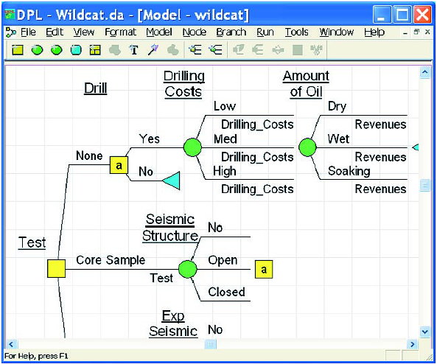
Decision Trees

Slide 28
Decision Trees
Define the problem
Structure or draw the decision tree
Assign probabilities to the states of nature
Estimate payoffs for each possible combination of decision alternatives and states of nature
Solve the problem by working backward through the tree computing the EMV for each state-of-nature node

Slide 29
Decision Tree Example
EMV for node 1
= $10,000
= (.5)($200,000) + (.5)(-$180,000)
Payoffs
Favorable market (.5)
$200,000
1
Unfavorable market (.5)
Construct large plant
-$180,000
Favorable market (.5)
$100,000
Construct small plant
2
Unfavorable market (.5)
-$20,000
Do nothing
EMV for node 2
= $40,000
= (.5)($100,000) + (.5)(-$20,000)
Figure A.2
$0

Slide 30
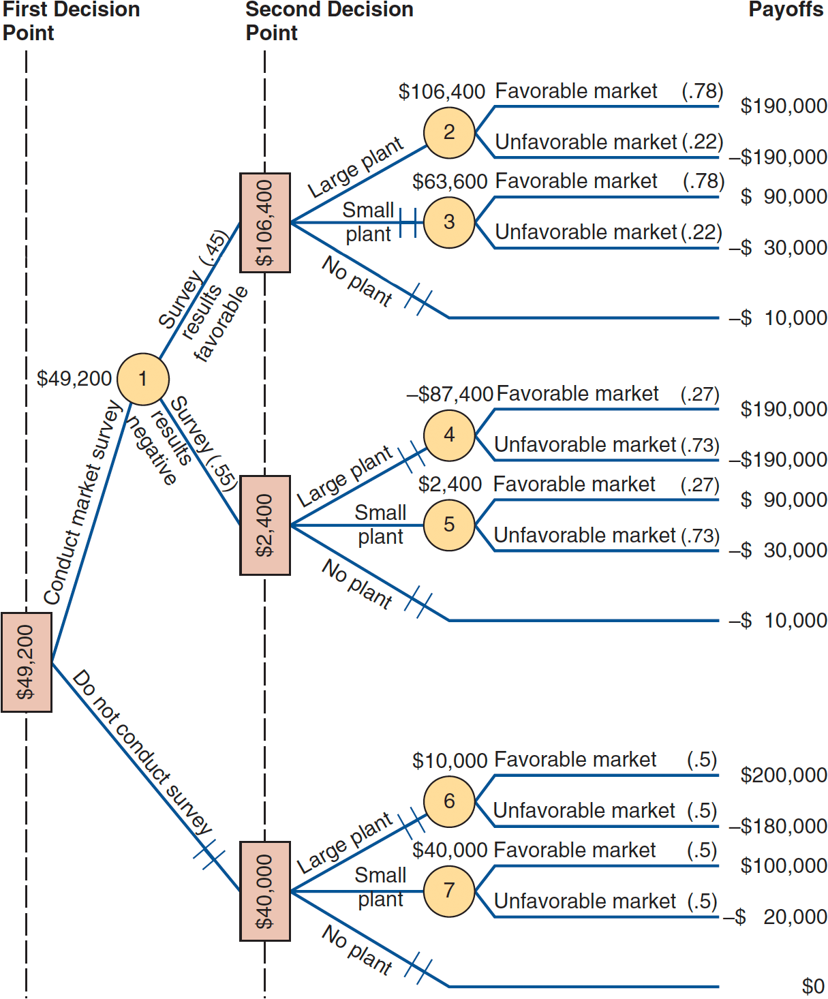
Complex Decision Tree Example
Figure A.3

Slide 31
Complex Example
Given favorable survey results
EMV(2) = (.78)($190,000) + (.22)(-$190,000) = $106,400
EMV(3) = (.78)($90,000) + (.22)(-$30,000) = $63,600
The EMV for no plant = -$10,000 so, if the survey results are favorable, build the large plant

Slide 32
Complex Example
Given negative survey results
EMV(4) = (.27)($190,000) + (.73)(-$190,000) = -$87,400
EMV(5) = (.27)($90,000) + (.73)(-$30,000) = $2,400
The EMV for no plant = -$10,000 so, if the survey results are negative, build the small plant

Slide 33
Complex Example
Compute the expected value of the market survey
EMV(1) = (.45)($106,400) + (.55)($2,400) = $49,200
If the market survey is not conducted
EMV(6) = (.5)($200,000) + (.5)(-$180,000) = $10,000
EMV(7) = (.5)($100,000) + (.5)(-$20,000) = $40,000
The EMV for no plant = $0 so, given no survey, build the small plant

Slide 34
Decision Trees in Ethical Decision Making
Maximize shareholder value and behave ethically
Technique can be applied to any action a company contemplates

Slide 35
Decision Trees in Ethical Decision Making
Action outcome
Is it ethical? (Weigh the affect on employees, customers, suppliers, community verses shareholder benefit)
Yes
Do it
Yes
No
Don’t do it
Does action maximize company returns?
Yes
Is action legal?
Is it ethical not to take action? (Weigh the harm to shareholders verses benefits to other stakeholders)
Yes
Don’t do it
No
No
Do it,
but notify appropriate parties
No
Figure A.4
Don’t do it

Slide 36
The Poker Design Process
If T. J. folds,
EMV = (.80)($99,000)
= $79,200
If T. J. calls,
EMV = .20[(.45)($853,000) - Phillips’ bet of $422,000]
= .20[$383,850 - $422,000]
= .20[-$38,150] = -$7,630
Overall EMV = $79,200 - $7,630 = $71,750

Slide 37

All rights reserved. No part of this publication may be reproduced, stored in a retrieval system, or transmitted, in any form or by any means, electronic, mechanical, photocopying, recording, or otherwise, without the prior written permission of the publisher.
Printed in the United States of America.

